Slide 1
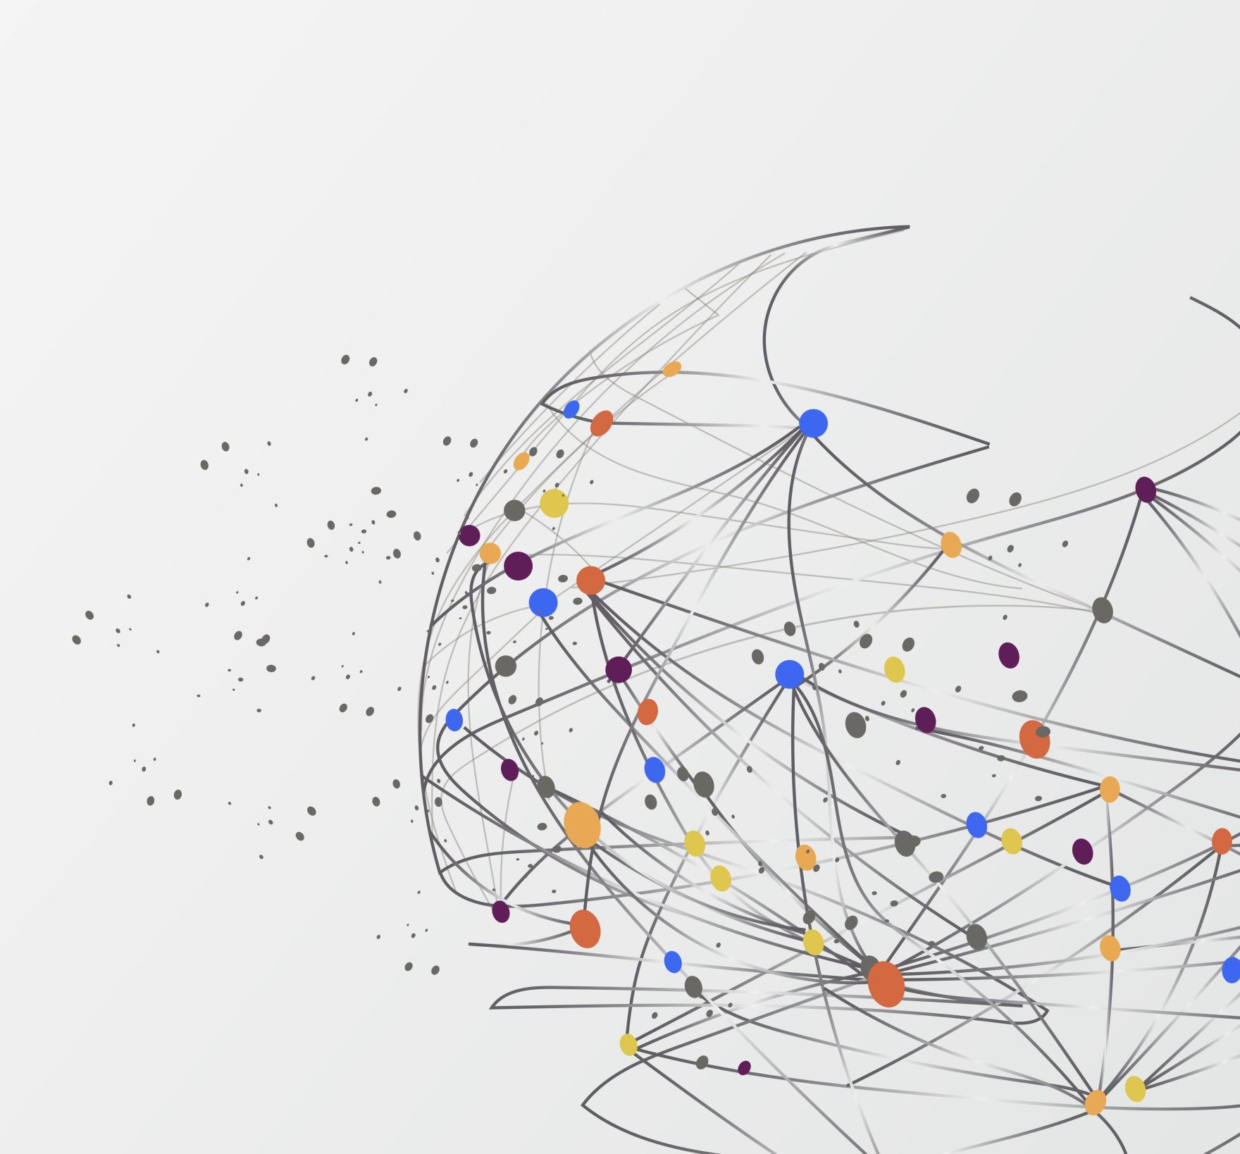

Dynamic Webpages
Understanding Modern Web Interactivity

Slide 2


Slide 3

What are Dynamic Webpages?
Imagine visiting a website that remembers your preferences, updates in real-time, and responds to your every click—without ever needing to reload. This is the power of dynamic webpages! Unlike static sites that show the same content to everyone, dynamic web pages personalize experiences, interact with databases, and deliver seamless functionality. From social media feeds to e-commerce recommendations, dynamic web technologies are the backbone of modern web interactivity

Slide 4

Static vs. Dynamic Webpages
Static Webpages :
Pre-built, fixed-content pages (similar to a digital brochure).
The same HTML/CSS/JS files are delivered to every user.
How They Work: The server sends the exact file stored on disk. No processing required
Pros: Fast loading (no server-side processing). Simple to host (no backend needed).
Cons: No personalization (e.g., "Hi, User!" is impossible). Manual updates (editing HTML files). Use Cases: Blogs, portfolios, informational websites.
Dynamic Webpages :
Content generated on the fly based on user, time, or data.
Uses server-side code (PHP/Python) or client-side JS.
How They Work: The server runs scripts to fetch data (e.g., from a database) and generates custom HTML
Pros: Personalized content (e.g., "Your Orders" on Amazon). Real-time updates (e.g., live sports scores).
Cons: Slower (requires server processing). More complex to build/maintain.

Slide 5
How Dynamic Webpages Work
User Request → Browser sends a request to the server.
Server Processing → Server runs scripts (PHP, Python, Node.js).
Database Interaction → Fetches or updates data (MySQL, MongoDB).
Response → Customized HTML sent back to the browser.

Slide 6

Examples of Dynamic Webpages
Social media (Facebook, Twitter).
E-commerce (Amazon, eBay).
Online banking portals.
Weather forecast sites.

Slide 7
Benefits of Dynamic Webpages
Personalized user experiences.
Real-time updates (e.g., stock prices, news).
Easier content management (CMS like WordPress).
Interactive features (forms, logins, carts).

Slide 8
Why are these examples Dynamic Webpages?
The displayed weather isn’t hardcoded—it’s generated on-demand based on user interaction and external data.
The list’s content is mutable and persists across visits.
The page behaves differently depending on user credentials, simulating a server-side response. adapting to user actions.
Prices change dynamically without manual refreshing, emulating real-world financial dashboards.
The displayed products adapt instantly to user preferences, offering a seamless shopping experience.

Slide 9
Keep it for practice !!!
Create an empty folder
Use your terminal to navigate and get into that empty folder
Type this: git clone https://github.com/BJcheng935/WDC_Dynamic_Website.git
Now you have a copy of the project on that folder.

Slide 10

Now let’s make our website public
We need a hosting platform; in this case, as an example, we will use Netlify
Here, we just need to have our files in a single folder and drag it into the website
Once it is there, Netlify will work on the rest, and that’s it!!!
You can customize the name of the site, disable the site, share it with other collaborators, etc.

Slide 11

Now let’s use Github
Github :
First, create a repository, make it public, and create it.
Then, upload the files using this:
git init
git add .
git commit -m "Initial commit"
git branch -M main
git remote add origin https://github.com/Here goes your user/Here the name of your repository.git
git push -u origin main
Once your files are in the repository we go to settings then pages, select “Deploy from a Branch,” scroll down, and select main / root.
Takes a few minutes, and it generates the link to visit our website.

Slide 12

Now let’s use Render
Netlify and Github do not support php. in case you want to create a project that includes php files, you can use Render.com. Remember to create repositories on Github to export your project more easily to other platforms.

Slide 13
